Slide 1

Server Under the Mountain (SUM)
Notes:
Alex

Slide 2
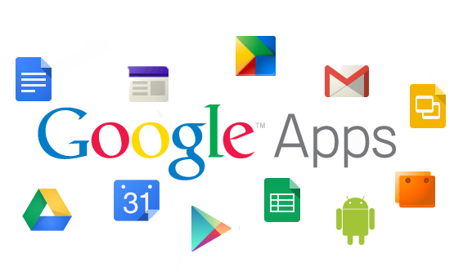
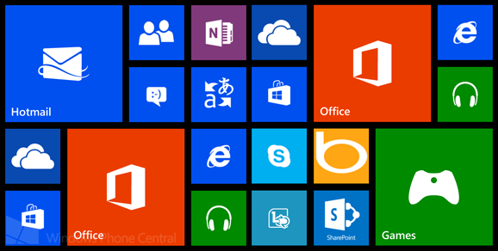
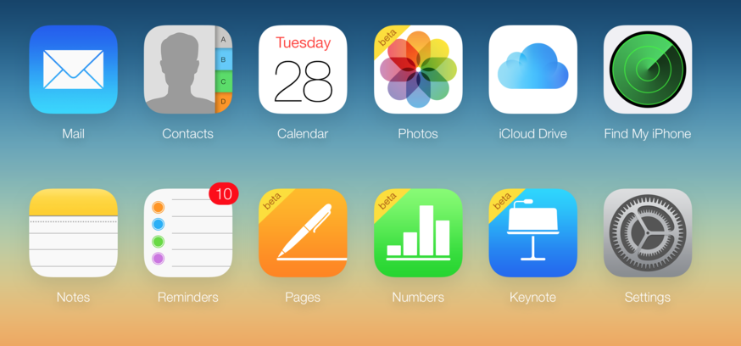
Problem
When you receive a free product then you usually are the product. Most companies track user behavior and collect personal information as part of their business model. User privacy continues to be a concern and individuals do not have the right tools to take complete control of their personal data.
Your most private data including notes, account information, and task lists are stored by major companies who can access the information any time.
Notes:
Alex

Slide 3

Notes
Passwords
Server Under the Mountain (SUM)
Open source solution for managing a private, secure, and highly scalable data repository.
Notes:
Luke - “ SUM offers resources on privacy practices, developer libraries for utilizing security features, and a suite of applications to replace the ‘big name’ company applications “

Slide 4
Security
Take Control Of Your Personal Data
Data never leaves your device without your permission, all notes and passwords are exclusively local.
Easy & Secure Backups
For when life’s accidents happen, you can rest assured that your data is available only to you.
Store encrypted backups on any cloud while keeping your data locked behind a master password.
Notes:
Collin

Slide 5
Additional Features
Free & Open Source
Peer reviewed code, security nerds approve.
Minimal Footprint
No bloatware, no ads, no trackers.
Incognito Mode
Blocks screenshots and hide content when you switch between apps.
Quick Search
Use #Hashtags, words, or phrases to find a note.
Notes:
Jessica, Michael (3 each)

Slide 6
End of Proposal
Up Next: Roadmap & Sprint Planning →

Slide 7
Server Under the Mountain (SUM)
Roadmap & Sprint Planning

Slide 8
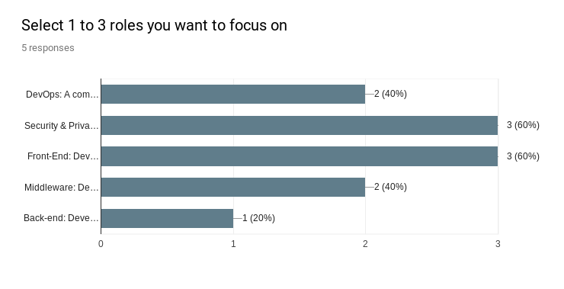
Notes:
The team completed a survey to see generally what each person is interested in. We have a pretty good spread of interests that cover all of our project’s requirements.

Slide 9
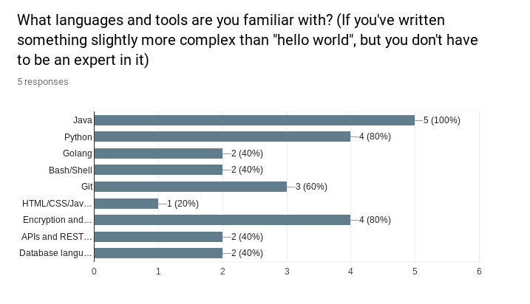
Notes:
In the survey we also tried to get a baseline of what experience our team has.

Slide 10
Primary Roles
Alex | Full Stack & Cross-Platform Developer
Collin | Architecture Lead, Full Stack & Cross-Platform Developer
Michael | Web Developer, Release Lead
Luke | Project Manager, Scrum Master, Android Developer
Jessica | Security Architect, Threat Analysis Documentor, Android Developer
Notes:
From the survey we started to delegate tasks based on primary roles. Everybody will get a taste for different parts of the project, this is just an overview of what each person will focus on.

Slide 11
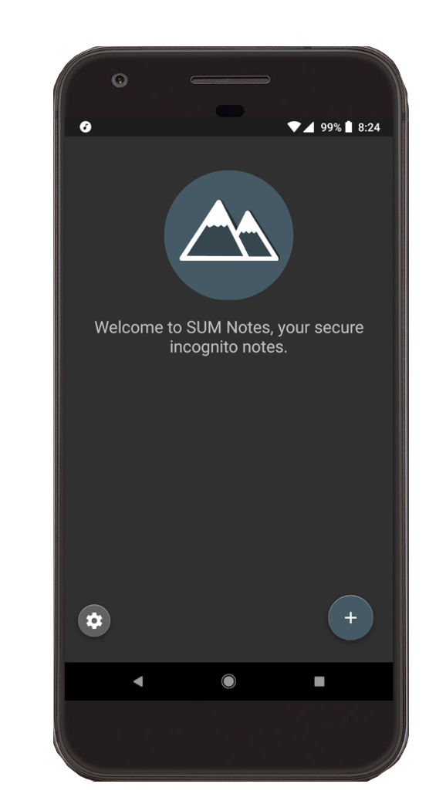
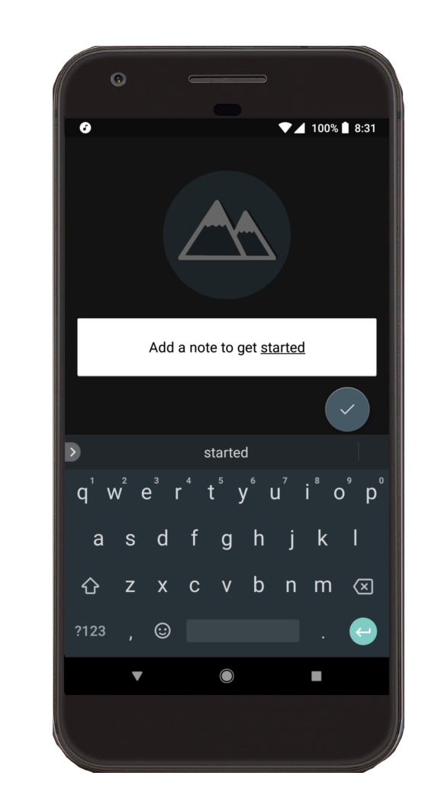
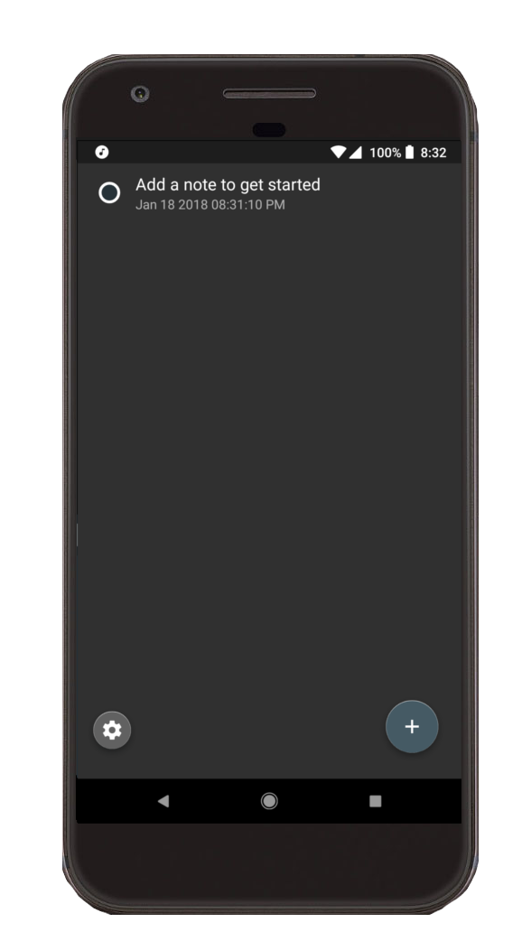
SUM Notes - Built for short thoughts and long markdown documents.
Proof of Concept for supporting mobile devices on our cross-platform software suite.
Notes:
Luke’s additional slide - “ Here’s a working proof of concept for our secure notes app. The interface keeps things simple and accommodates a range of use cases, from quick notes to extensive markdown documents. All of this currently works and has an optional server side for backups.” ---- NOTE that “level 0 and level 1 security options” is explained next in Collin’s slide

Slide 12
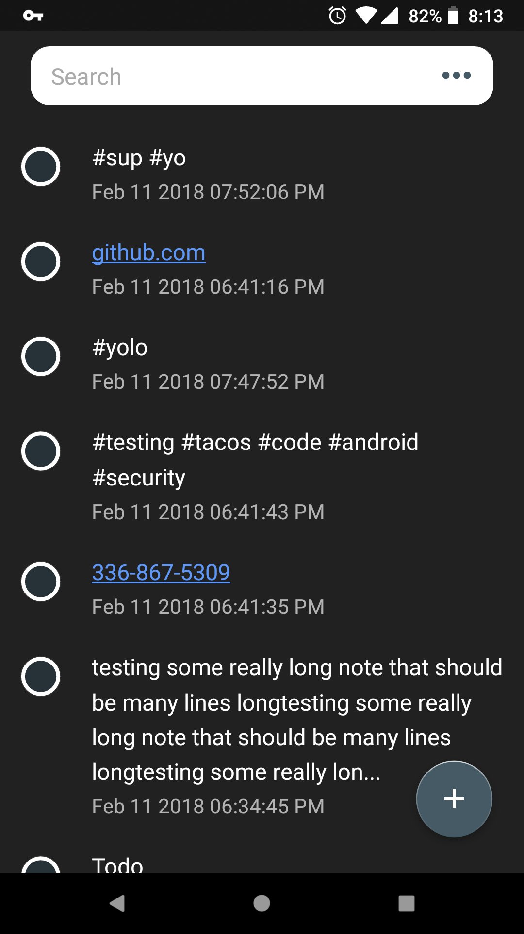
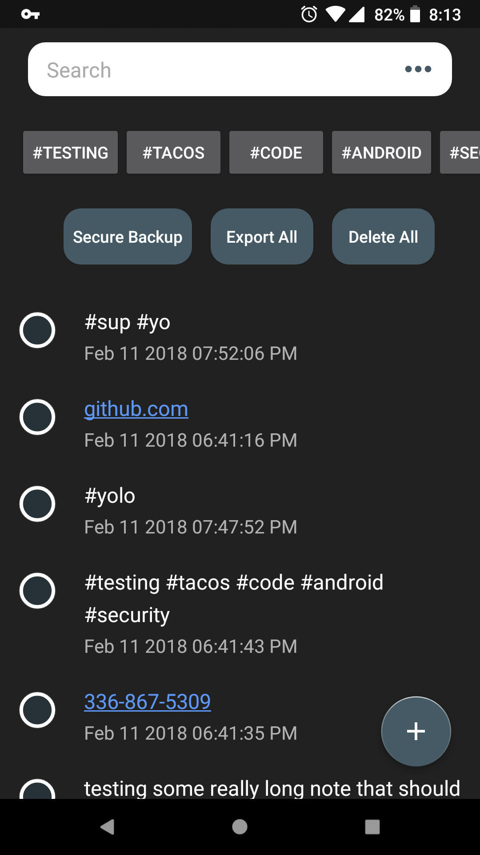
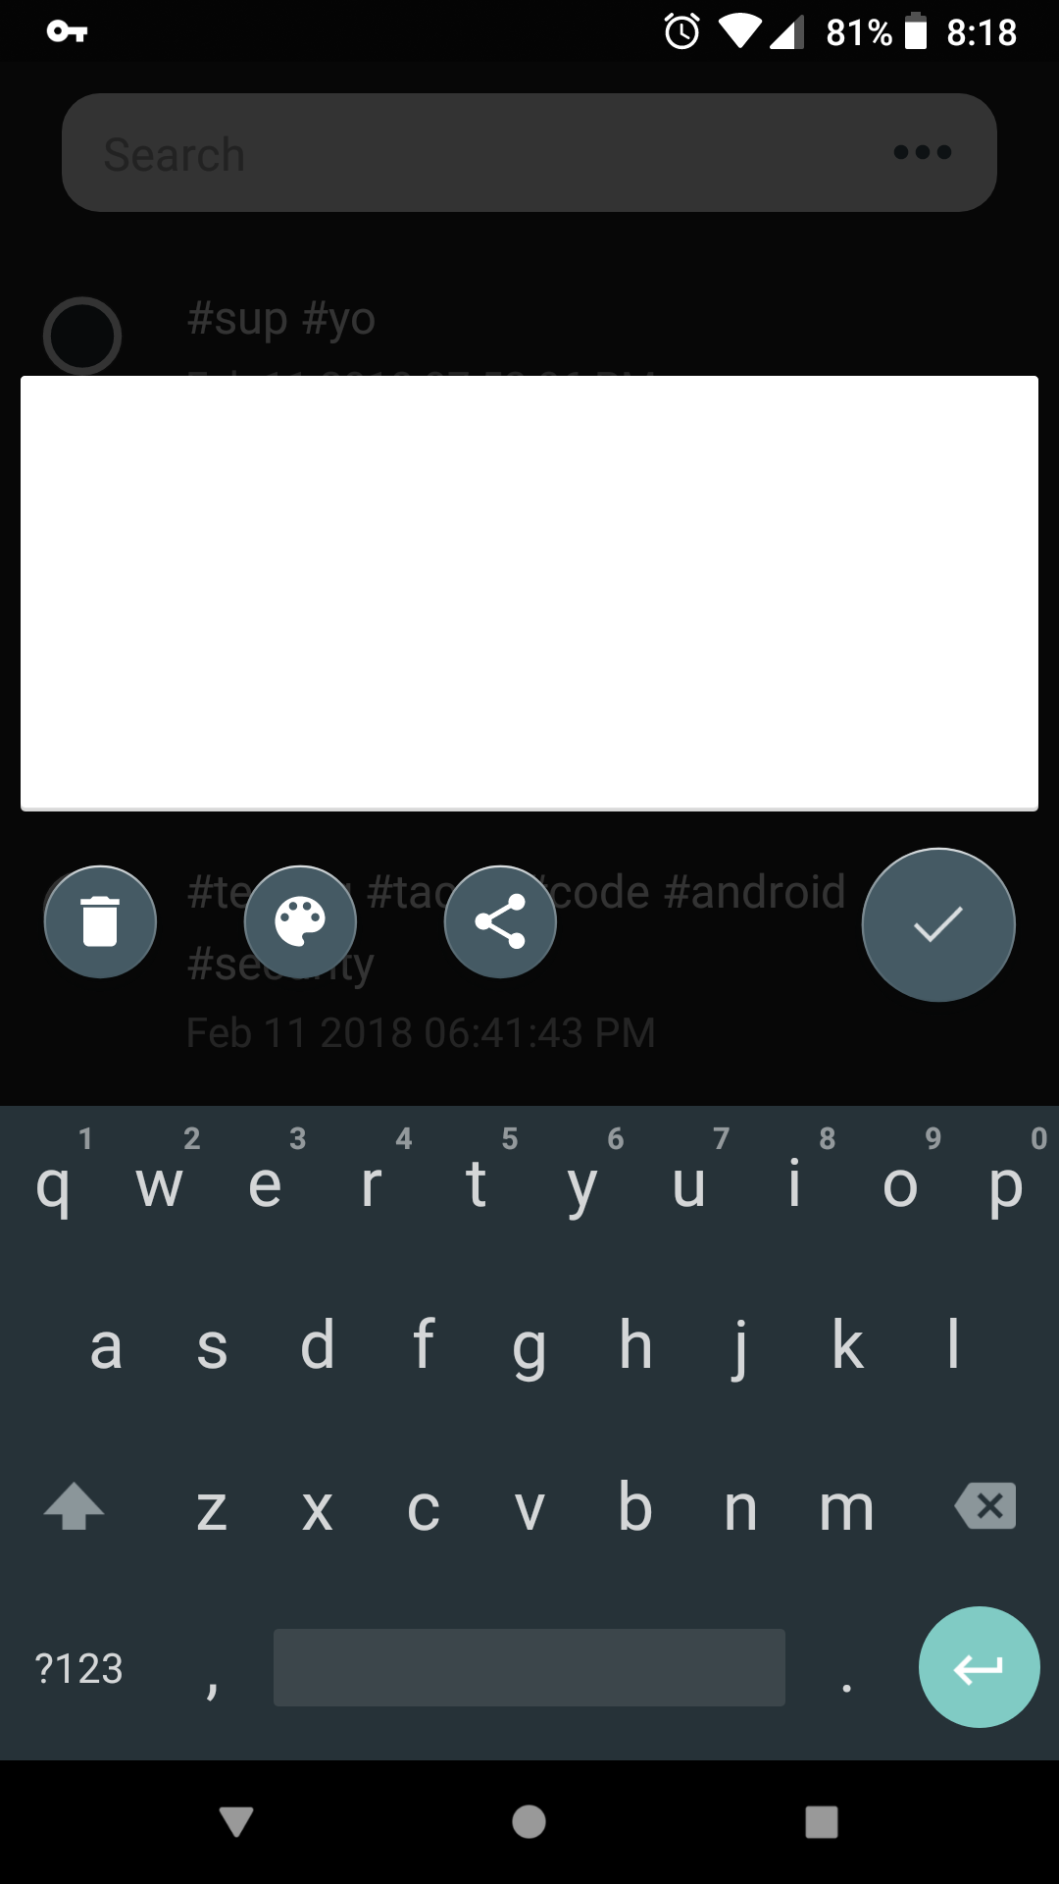
SUM Notes - Progress
Automatically creates links for urls, phone numbers, email addresses, map addresses, and tags.
Ability to search through notes
Tap a tag below the search bar to show all notes with the same tag
Support for short notes and long lists
Blocks other apps from acquiring screen content, blocks screenshots, uses API to request incognito mode for keyboard
Option to export all data to another app that accepts strings or quick purge of all data
Notes:
Collin

Slide 13
Web Presence
Create a splash page that explains what SUM is and what we have to offer. This is served in the GitHub repo and requires no hosting or maintenance.
Getting started - Jekyll
Create a repository on GitHub and use one of their “GitHub Pages Templates” as an initial version.
Customize the template, theme it, add logo, and start writing marketing content that tells users what we have to offer.
Notes:
Jessica

Slide 14
End of Roadmap & Sprint Planning
Up Next: Requirements -->

Slide 15
Server Under the Mountain (SUM)
Requirements

Slide 16
Problem
When you receive a free product then you usually are the product. Most companies track user behavior and collect personal information as part of their business model. User privacy continues to be a concern and individuals do not have the right tools to take complete control of their personal data.
Your most private data including notes, account information, and task lists are stored by major companies who can access the information any time.
Notes:
Alex

Slide 17
Requirements
Functional
Front-end application for input of Note content
Locally encrypted database
Read/Write locally encrypted database by entering the encryption password
Usability
Minimalistic layout and controls designed for the average user
Technical functionality is available for more experienced users
Public webpage with all privacy and security policies outlined for users
Notes:
Denney

Slide 18
Requirements
System
Hardware: Mobile Device
Software: Android Operating System
Database: NoSQL DB (encrypted)
Privacy & Security
Block other apps from acquiring screen content
Block screenshots
Requests incognito mode from system keyboard
NoSQL database (AES 256 encrypted)
All data stays encrypted locally unless you use the export tool
Notes:
Michael

Slide 19
Subsystems
Encryption Subsystem
AES encryption
AES decryption
File Management Subsystem
Add, edit, delete notes
Broad data actions (eg. delete all)
Search Management Subsystem
Search by tag: use a regular expression to parse hashtags in notes for categorical grouping
Search by phrase: raw string searching
Notes:
Luke
AES Encryption/Decryption
File management
Search Management
Broad Data Actions (i.e. Delete All)
Import/Export of encrypted data files
User Interface & User Experience Design

Slide 20
Subsystems
Import & Export Subsystem
Local Storage: Reference offline files
Cloud Storage: References backups stored on different cloud services
UI & UX Subsystem
Android app
Notes:
AES Encryption/Decryption
File management
Search Management
Broad Data Actions (i.e. Delete All)
Tag filtering
Import/Export of encrypted data files
User Interface & User Experience Design

Slide 21
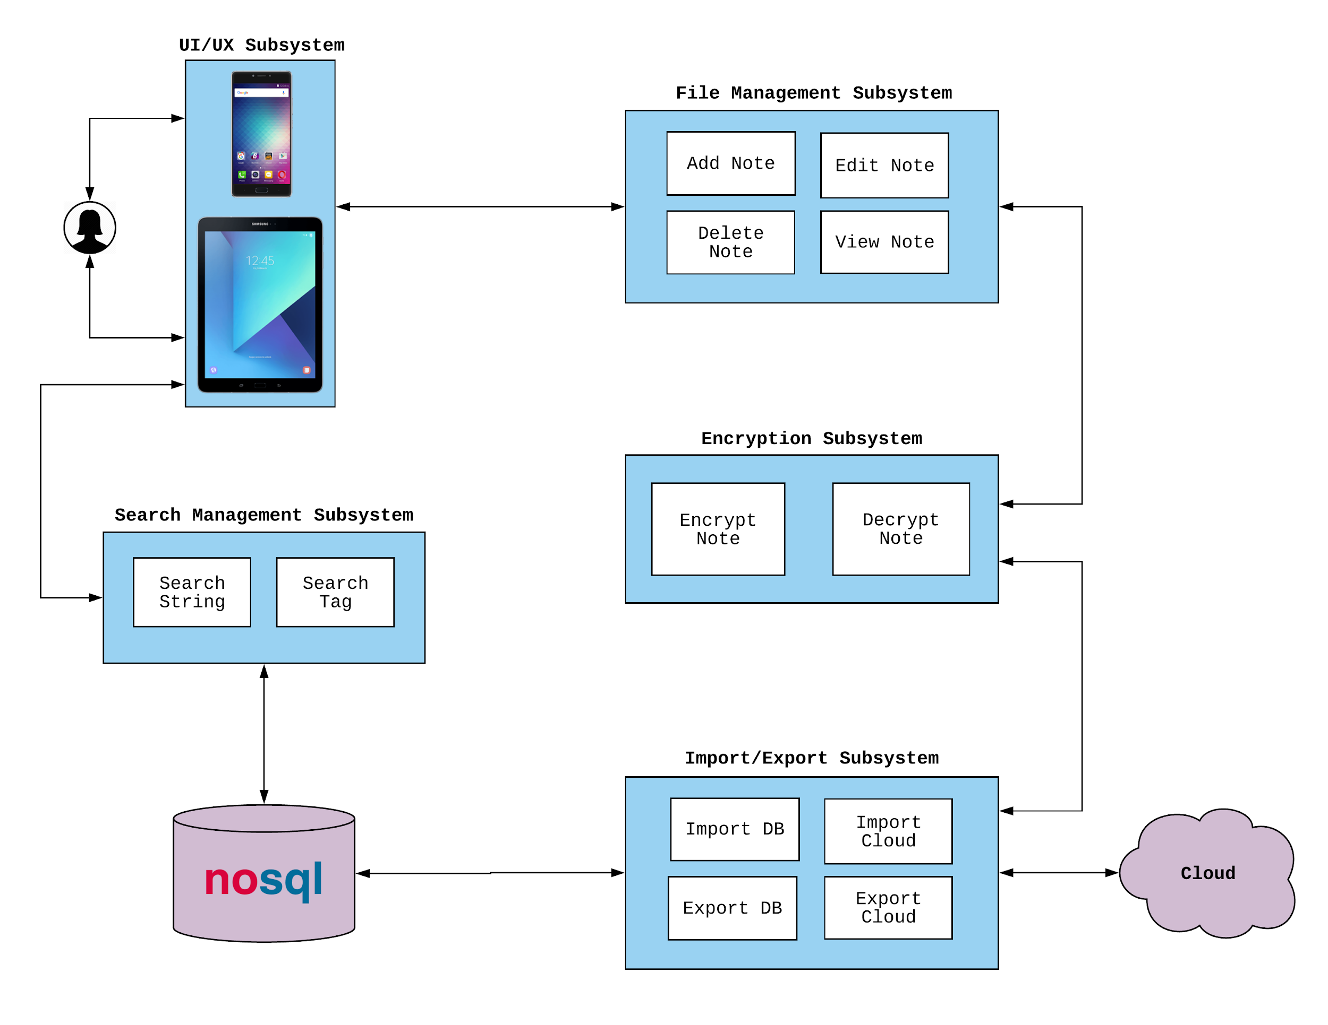
Subsystems

Slide 22
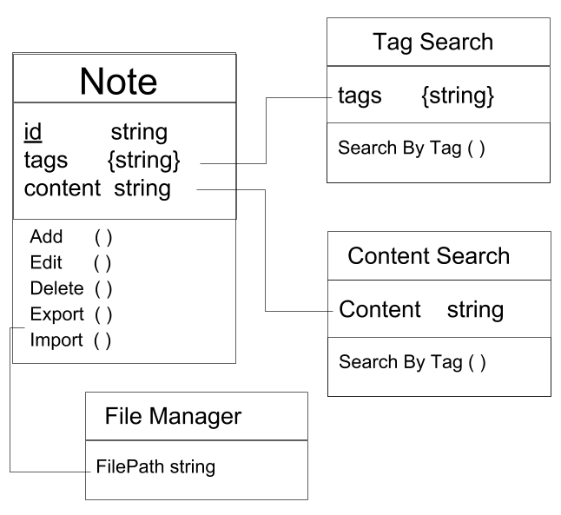
ER Model

Slide 23
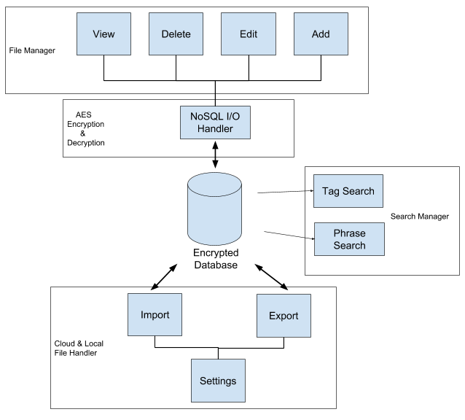
Subsystem Communication

Slide 24
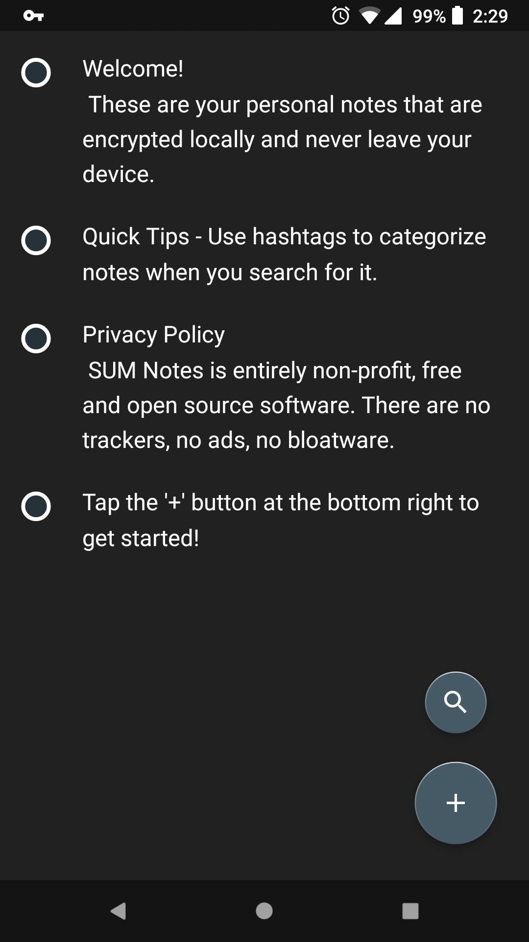
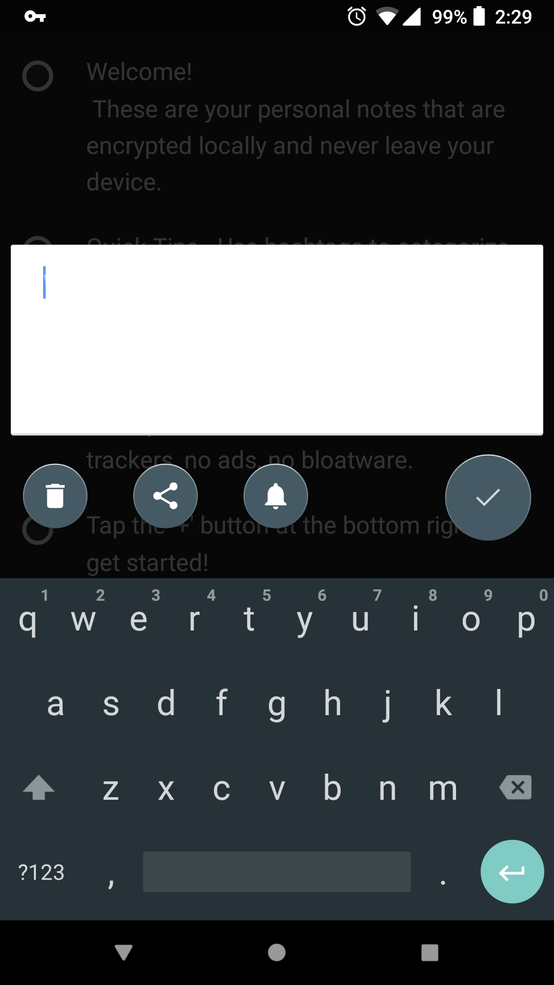
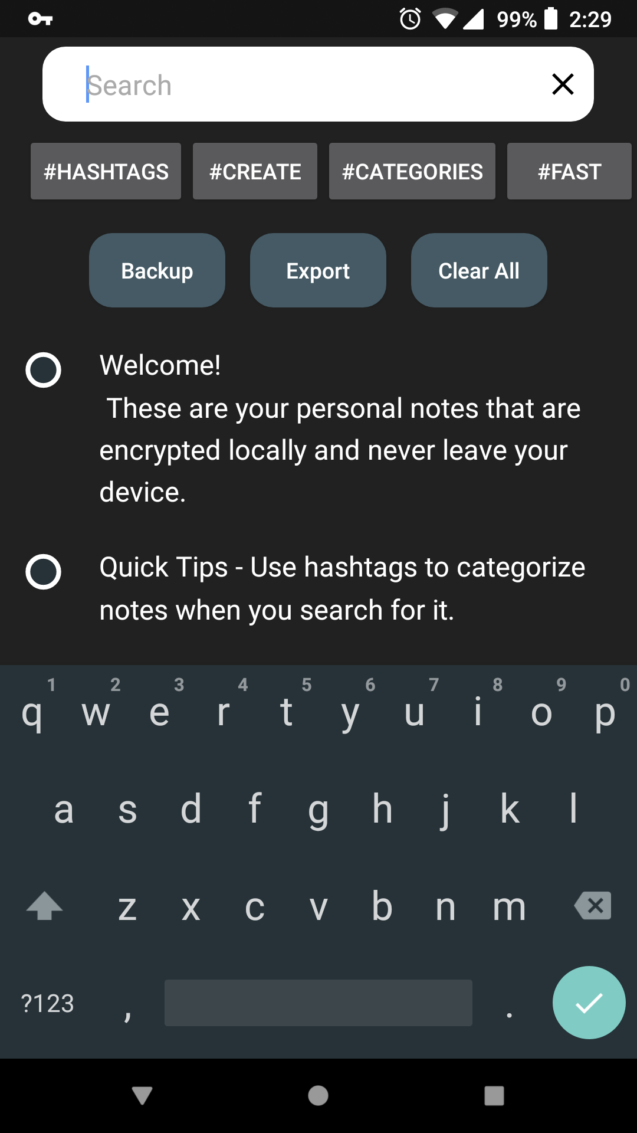
User Flow
Download the app from the Google Play Store and open it
Learn about the privacy policy and security features by reading the default notes
Enter personal note content
Notes:
Collin

Slide 25
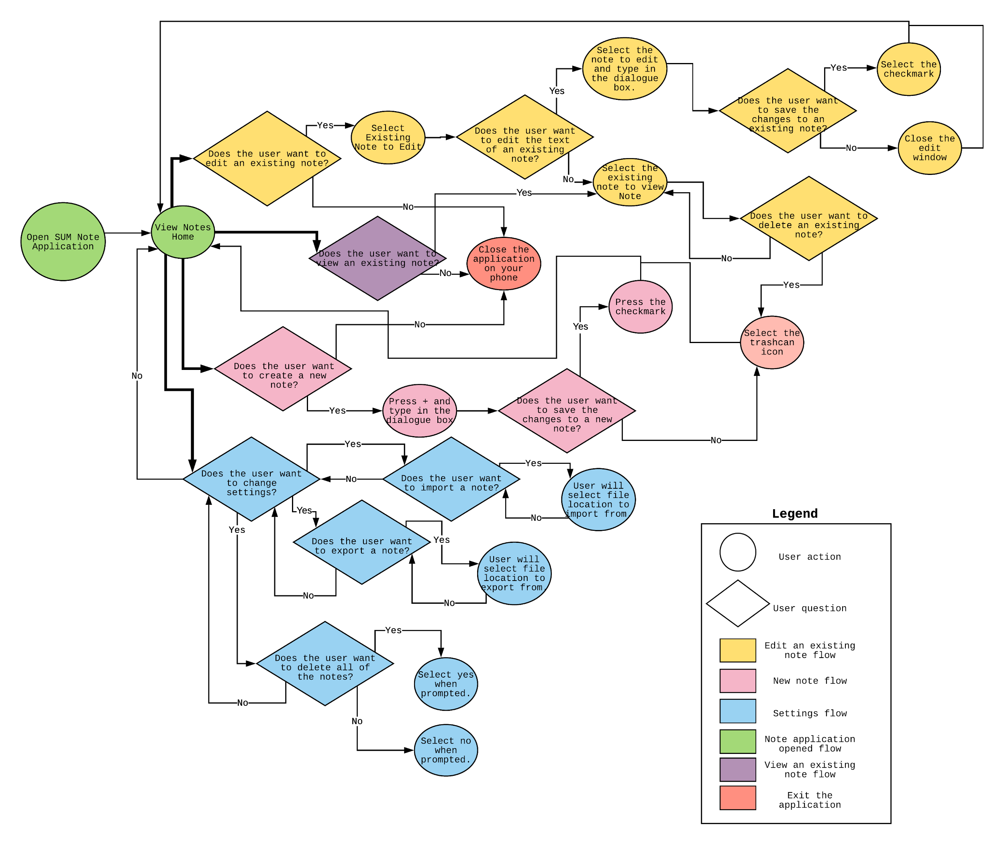
User Flow

Slide 26
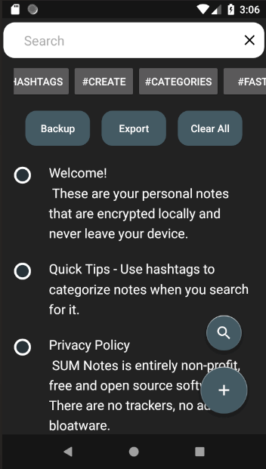
Detailed Design and Controls
Closes search bar and commands
Lets the user search by string or hashtag
Direct way to search by available hashtags
Opens search bar and commands
Quick commands for all data
Opens new note editor
A note. This one is preloaded as a user guide
Notes:
Luke

Slide 27
Data Dictionary
One primary object that’s stored in an encrypted database: Note (long id, string content, string tags)
Table Structure | CREATE TABLE NOTES ( _ID INTEGER PRIMARY KEY AUTOINCREMENT, CONTENT TEXT, TAGS TEXT)
Add Note | INSERT INTO NOTES ( CONTENT , TAGS )
Update Note | UPDATE NOTES SET ( CONTENT, TAGS ) WHERE _ID = X
Remove Note | DELETE FROM NOTES WHERE _ID = X

Slide 28
Algorithm Analysis
Loading encrypted data: NoSQL.decodeDBFile(<pw>)
Writing encrypted data: NoSQL.add(<string>)
Importing data files: Small text strings, not resource intensive
Parsing tags: Search newly inserted note content for hashtags using regex and store the list with references to the row ID - O(n) for string length
Notes:
Collin

Slide 29
(Optional) Cloud Services
Cloud services can use utilized to provide easy storage of data. Since it’s encrypted using a password that only you know, the cloud storage provider has zero knowledge of your data.
Pick any cloud provider service
The cloud provider must be on the device
Uses built in Android feature to copy data from one app to another
Data will be encrypted before being copied to other apps
All data will be locked behind the user’s password
Notes:
Denney

Slide 30
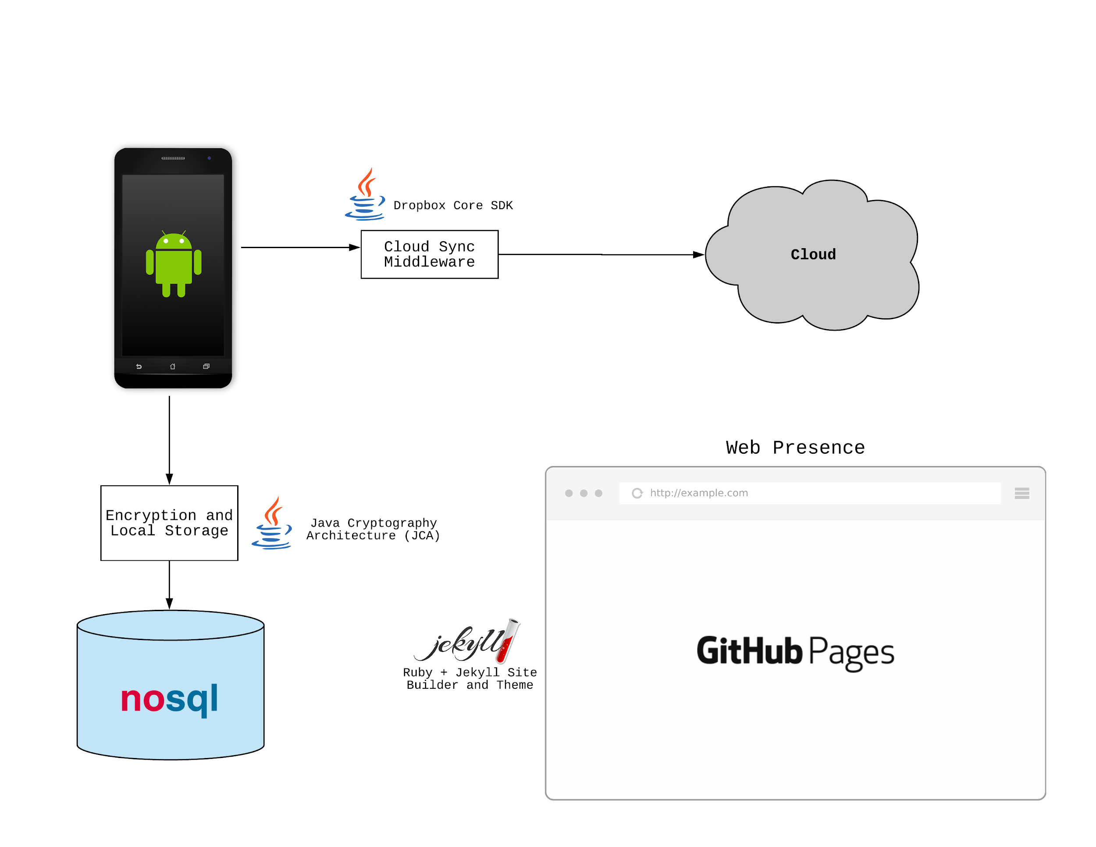
Architecture

Slide 31
End of Requirements
Up Next: Scrum Report →

Slide 32
Server Under the Mountain (SUM)
Scrum Report
Notes:
Luke Pitch

Slide 33
Problem
When you receive a free product then you usually are the product. Most companies track user behavior and collect personal information as part of their business model. User privacy continues to be a concern and individuals do not have the right tools to take complete control of their personal data.
Your most private data including notes, account information, and task lists are stored by major companies who can access the information any time.
Notes:
Alex

Slide 34
Sub-System Communication
Notes:
Collin

Slide 35
Sprint Roadmap (2 week sprints)
1 (1/22 - 2/2) | Basic Notes App - (Collin, Alex, Jessica, Michael, Luke) Local storage No encryption Add notes Edit notes Delete notes
2 (2/5 - 2/16) | Encryption/Decryption - (Collin, Alex, Jessica) Encrypt with AES Decrypt with AES Searching/Tag Filtering - (Collin, Luke, Michael) Add tags to notes Removes tags Search for a tag Select a tag
3 (2/19 - 3/2) | Security - (Jessica, Collin) Master password to access secure notes file Cloud Sync - (Alex, Luke) Send encrypted notes to cloud storage Web Presence - (Michael) Information detailing… Security in the app Privacy policies Functionality and instructions
Notes:
Alex
Don’t go into too much detail on this. Basically we’re prioritizing the “SUM Notes” app, making sure it’s secure at the ground level in addition to offering a secure cloud backup option. We’ll see how these sprints turn out… it wouldn’t be smart to plan too far out since we’re in the early stage of being a team.

Slide 36
Sprint Roadmap (2 week sprints)
See More on our GitHub page
4 (3/12 - 3/23) | Password Manager - (Collin, Luke, Jessica, Michael, Alex) Add passwords Edit passwords Delete passwords Copy/autofill password to another application for login
5 (3/26 - 4/6) | Security Audit - (Collin, Luke, Jessica) Detail flow of information Detail security measures Web Presence 2.0 - (Michael, Alex) Information detailing... Storage of password data Functionality and instructions
Notes:
Collin, then Denney
CODE LOCK: 4/6 (Final Project)
Focus all work on final presentation and supporting documents 4/9 - 4/13
Don’t go into too much detail on this. Basically we’re prioritizing the “SUM Notes” app, making sure it’s secure at the ground level in addition to offering a secure cloud backup option. We’ll see how these sprints turn out… it wouldn’t be smart to plan too far out since we’re in the early stage of being a team.

Slide 37
End of Scrum Report

Slide 38
Server Under the Mountain (SUM)
Scrum Report 3/19

Slide 39
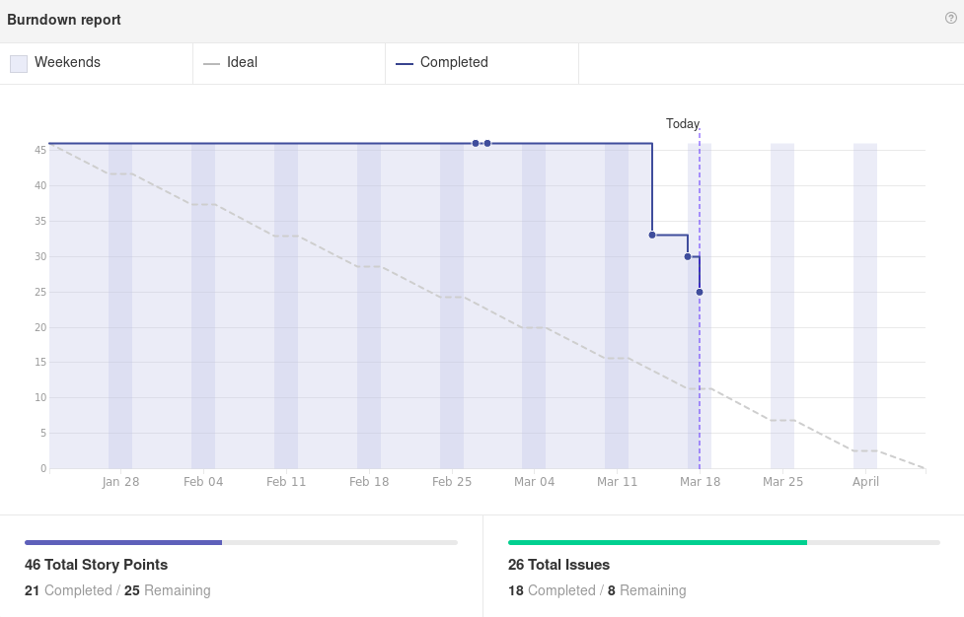

Slide 40
Alex
Worked on:
Import/Export Subsystem
Began work on cloud sync
Issue #15: As a user I want to backup my notes
This Sprint:
Finish cloud sync implementation
Android Share Intent

Slide 41

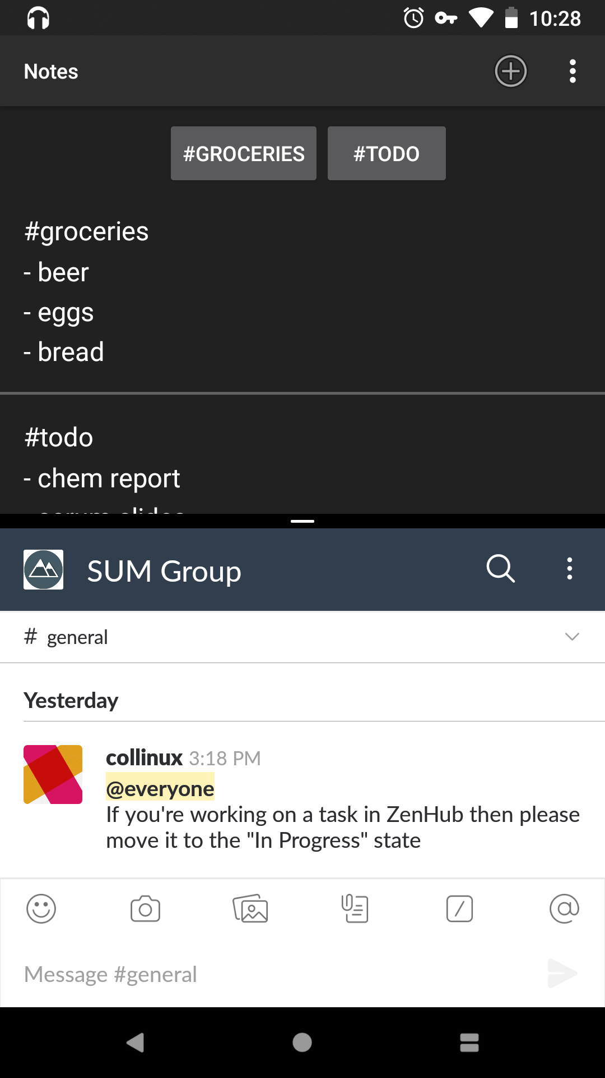
Collin
Worked On
Redesign of logo
Tag Parsing: All #hashtags dynamically parsed on startup, when a note is edited, and when a note is deleted.
Support for split view mode
Highlight text in any other app to share it with SUM Notes
This Sprint
Ability to set a master password on first startup and prompt for passphrase each time the app opens. (started last sprint)
Design of password storage interface

Slide 42
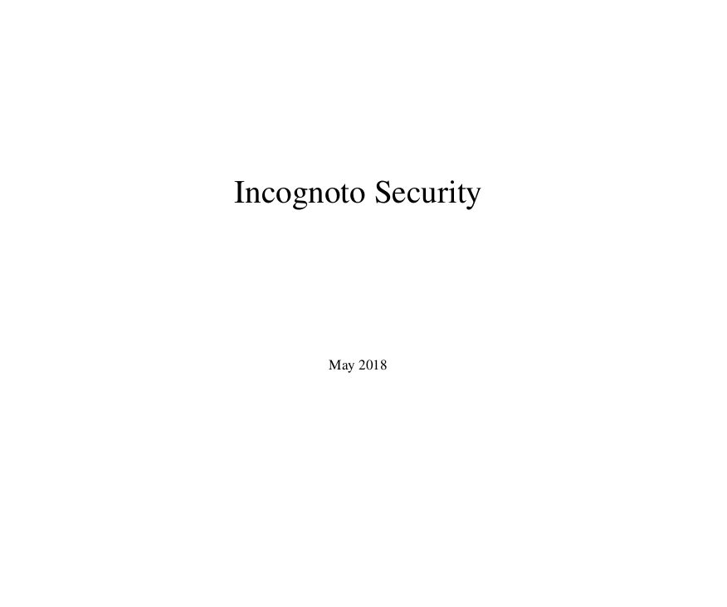
Jessica
Worked on:
User Security Policy
Terms of Service
Privacy Policy
Issues:
As a user I want to understand the privacy and security policies before I install the app
This Sprint:
Researching and implementing a biometric option for decryption
Finishing security documentation
User Manual

Slide 43
Luke
Worked on:
Duplicate Note Filtering
Failed and then back end database changed
SearchManager
Issues:
As a user, I want to avoid having duplicate notes - 3
As a user, I want to search for notes containing word(s) - 5
This Sprint:
Continuing SearchManager
Issues:
As a user, I want to search for notes containing word(s) - 5

Slide 44
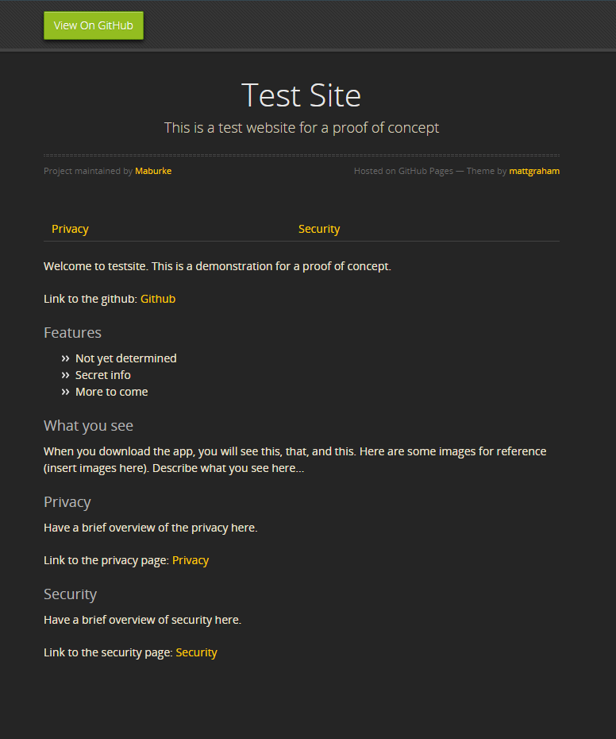
Michael
Worked on:
POC for our website
Researched how to work with Github Pages
Researched Github flavored markdown
https://maburke.github.io/test-website/
This Sprint:
Help work on Privacy and Security Policies
Setting up our website for the notes app

Slide 45
Server Under the Mountain (SUM)
Scrum Report 3/26

Slide 46
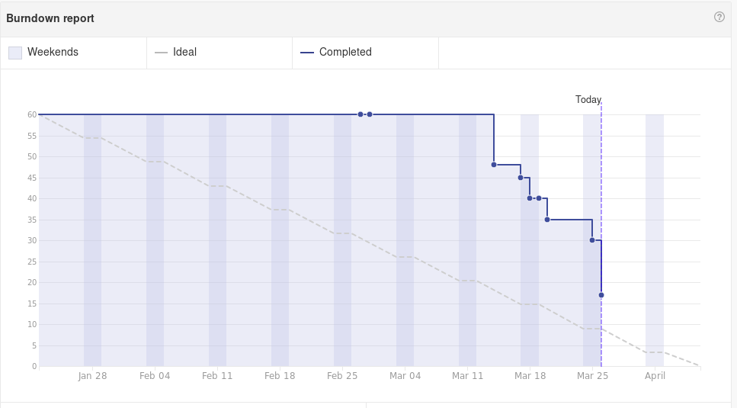

Slide 47
Alex
Worked on:
Import/Export Subsystem
Issue #15: As a user I want to backup my notes (7 points)
Continued work on cloud sync
The app is able to initiate the Intent to share content
BUT, the receiving end is not receiving properly
We may want to save to device storage and sync from there
This Sprint:
Finish cloud sync functionality

Slide 48
Collin
Worked On
Use a YubiKey NEO as a hardware authentication method (5)
Password generated on startup (3)
Ability to change password (3)
Front end for search input (3)
This Sprint
UI picker for authentication methods
Ability to restore notes from a backup

Slide 49

Jessica
Worked on:
Continued Work on User Security Policy
Terms of Service
Privacy Policy
Issues:
As a user I want to understand the privacy and security policies before I install the app(5)
This Sprint:
Researching and implementing a biometric option for decryption(5)
Finishing security documentation
User Manual

Slide 50
Michael
Worked on:
Added default notes (Welcome, features, security/privacy) ( 2)
Added to future website (1)
Duplicate tags(needs to be continued) (3)
This Sprint:
Duplicate tags(3)
Improve change password interface and check for valid input(3)

Slide 51
Luke
Worked on:
SearchManager
As a user, I want to search for notes containing word(s) (5)
This Sprint:
SearchManager
I want to be able to search for notes containing a term (7)
I want to be able to search for notes containing two terms (3)

Slide 52
Incognoto
Project Report 3

Slide 53
Why Incognoto?
Corporations are constantly collecting your private, personal information.
In fact, many companies track your behavior and collect your data as part of their business model (lookin’ at you Zuck). User privacy continues to be a concern and individuals do not have the right tools to take complete control of their data.
Incognoto, the secure notes app, is the solution to this growing problem.
Leveraging advanced cryptographic tools and strict security policies, your ideas, thoughts, and secrets are safe with Incognoto.
Notes:
Alex

Slide 54
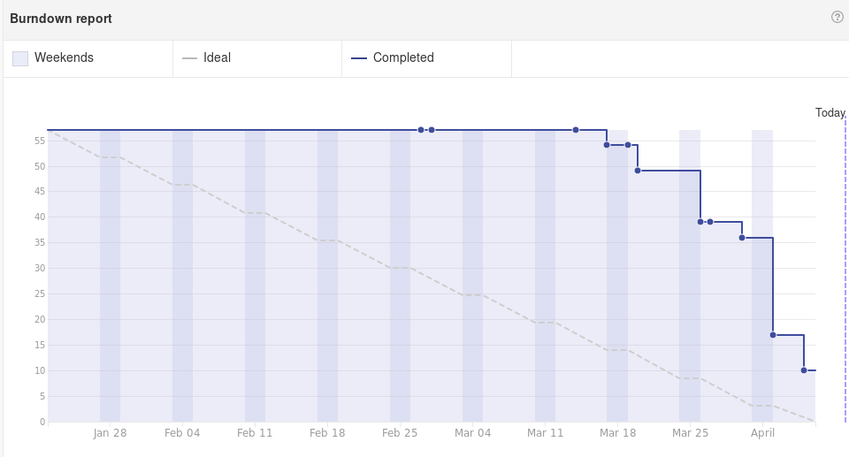

Slide 55
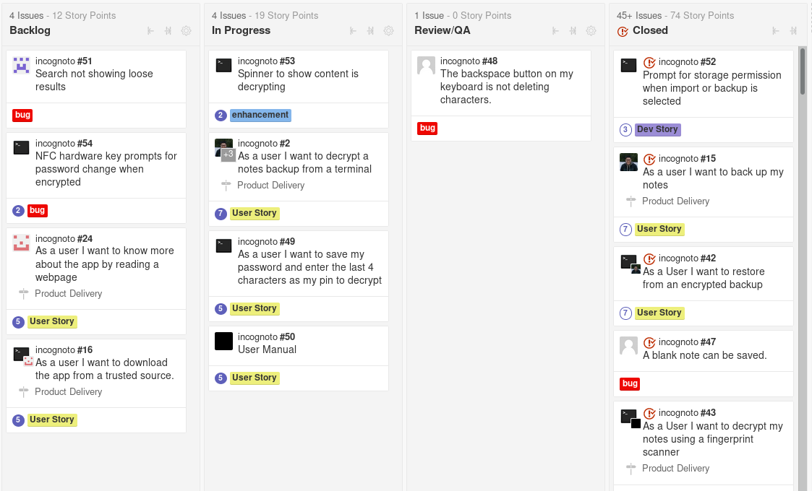

Slide 56
Cryptographic & Authentication Subsystem
Developed by Collin
Initial Design: Encryption using SQLCipher on top of an SQLite database.
Pros:
Easy to implement
SQL Query strings
Cons:
Large library (20MB) - goes against our marketing offering of a minimal footprint
Unaudited library - does not follow our fundamental security values
Improved Design: Encryption using native Java crypto library.
Pros:
Easily auditable
Low Footprint
Cons:
Large amount of time to implement
Must develop query algorithm, import, export, and salt functions

Slide 57
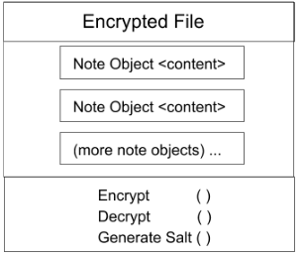
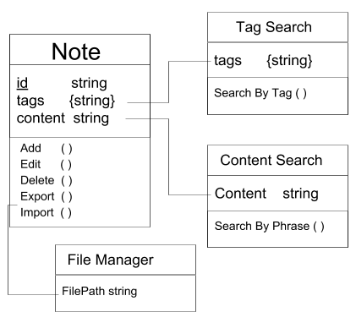
Cryptographic & Authentication Subsystem
Document driven NoSQL database for encrypting and decrypting notes. Handler for data I/O that interfaces with the front end. Uses the native java.crypto and java.security classes, no external libraries.

Slide 58
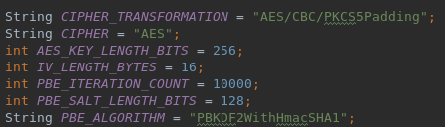
Cryptographic & Authentication Subsystem
Ensures Confidentiality, Integrity, and Accessibility of the whole system
Encryption validated by exporting the data file and inspecting the contents on another system.
Training: this is a back-end component and the user will only interact with this subsystem through the import/export subsystem.
As a user I want to
… have all note content encrypted (13) - Done
… to define a master password (3) - Done
… export my encrypted notes (7) - Done
… use a YubiKey NEO / NFC for auth (5) - Done
... import my encrypted notes (7) - Done
… have partial password/pin as quick unlock(7) - In Progress

Slide 59
Scrum Report - Collin
Worked On
Researched Fingerprint scanner authentication - Encountered many issues with the native Java classes since it’s not a simple implementation, it comes in contact with many of our subsystems. (7)
Partial Password: quick unlock method, save the password except for the last 4 characters. Only require the first 4 characters on startup to decrypt. (5)
Ability to import the encrypted notes file to the downloads folder of Android. “As a user I want to import my encrypted notes” (7)
Prompt for storage permission to use import/export functions (3)
This Sprint
Squash a couple minor bugs (1 - 2 story points each)
Preparation of Google Play Store listing (5)

Slide 60
Search Subsystem
Luke
Through the main screen the user can access a search bar. This subsystem is the backend for that functionality.
String based search system that returns notes that contain matches to the entered query. Uses java. Offers advanced operations for searching multiple terms at once.
And, (“[term ]+[term]”): Searches for notes containing both terms. Each term may be independent of the other in the note.
Or, (“[term]|[term]”): Searches for notes containing either term.
Not, (“~[term]”) : Searches for notes that do not contain a term.
This system works in tandem with the file management subsystem. It is passed an ArrayList of notes and a query string, and returns an ArrayList of notes.
Story #9: I want to tag notes and group them by tag (3)
Story #10: I want to be able to search for notes containing term(s)(7)

Slide 61
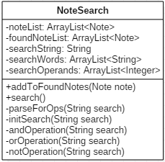
Data Dictionary
ArrayList<Note> - noteList: Master list containing all notes that are saved in the app.
ArrayList<Note> - foundNoteList: List produced at search that contains all notes that hold the searchString
String - searchString: String that is being searched
ArrayList<String> searchWords - List containing the search string parsed into individual search terms
ArrayList<Integer> searchOperands - List containing a list of operations corresponding to individual search terms

Slide 62
Design
The query string is parsed for characters that denote operators. Each operator is stored as a different value in searchOperands. The strings that exist between these operators are stored in searchTerms. Once completed, the search function performs the appropriate operation search on each corresponding term. Once there are no more terms, the search is complete.

Slide 63
Search - Plan and Testing
1.) Populate notes with various amounts of simple strings from a predetermined set similar to {hello | world | yes | no | maybe | yay | please | work}
2.) Test searches on various single strings. Check to see all appropriate notes are returned.
3.) Test searches on various pairs of strings with an and (+) operator. Check to see all appropriate notes are returned.
4.) Test searches on various pairs of strings with an or (|) operator. Check to see all appropriate notes are returned.
5.) Test searches on various pairs of strings with a not (~) operator. Check to see all appropriate notes are returned.
6.) Test searches with two or more operators on three or more strings. Check to see all appropriate notes are returned.

Slide 64
Scrum Report - Luke
Worked on:
Getting search working; ran into multiple bugs and issues.
Story:
#10: I want to be able to search for notes containing term(s)(7)
This Sprint:
Refining search and increasing its usability
Stories:
Increase general usability of search operations (2)
Remove case sensitivity from search (2)

Slide 65
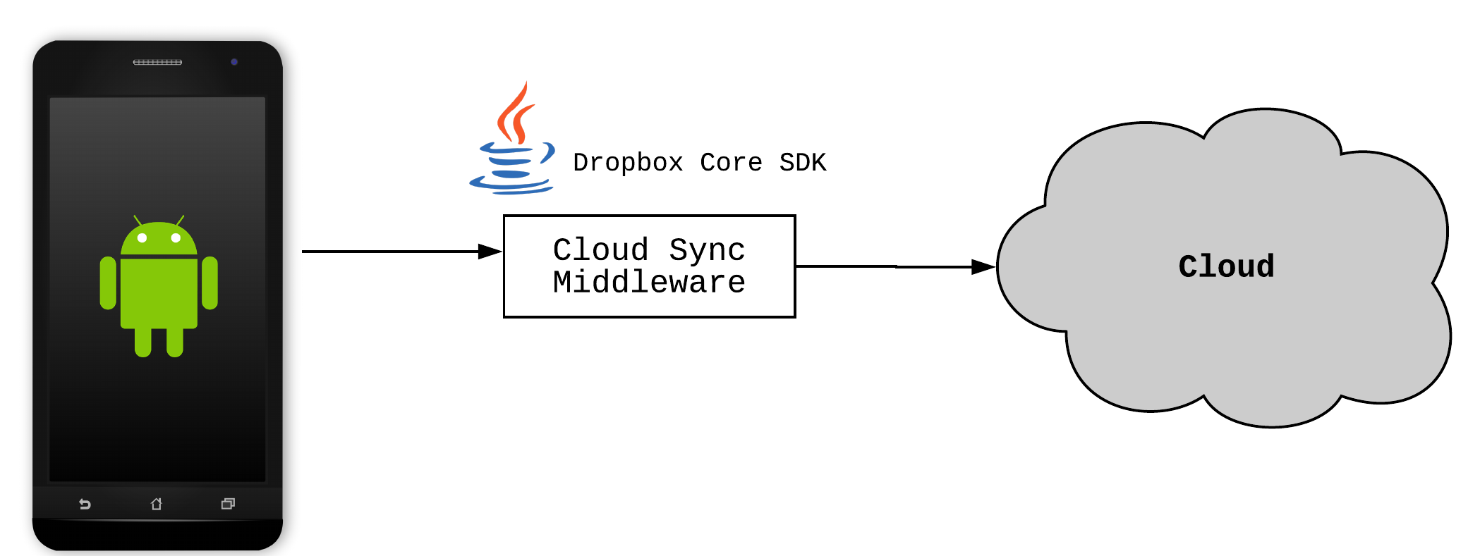
Import/Export Subsystem
Alex
Initial Design and Model
Allow user to directly backup and sync their notes using a third-party cloud provider
Initially decided to support Dropbox (using the Dropbox Core API)
Pros:
Ease-of-use (one-tap and/or automated backup process)
Notes can be secured by encryption before sending to third-party
Cons:
Security risks by using an outside API
Reduces transparency and auditability of our app

Slide 66
Import/Export Subsystem, continued
Data Dictionary
Single encrypted file stores all Note objects
Each note object is separated with a delimiter “\n---\n”
Refinements
Decided not to connect any external APIs to our app
Security concerns regarding external services, especially those that handle user data
We’re making this app for paranoid users, so we will be paranoid developers!
Notes are encrypted and exported to ‘Downloads’ folder (local storage)
User can then go into file explorer and use Dropbox (or similar app) to import the file
Pros:
Increased security
Significantly reduced app size
Cons:
More complicated backup process

Slide 67
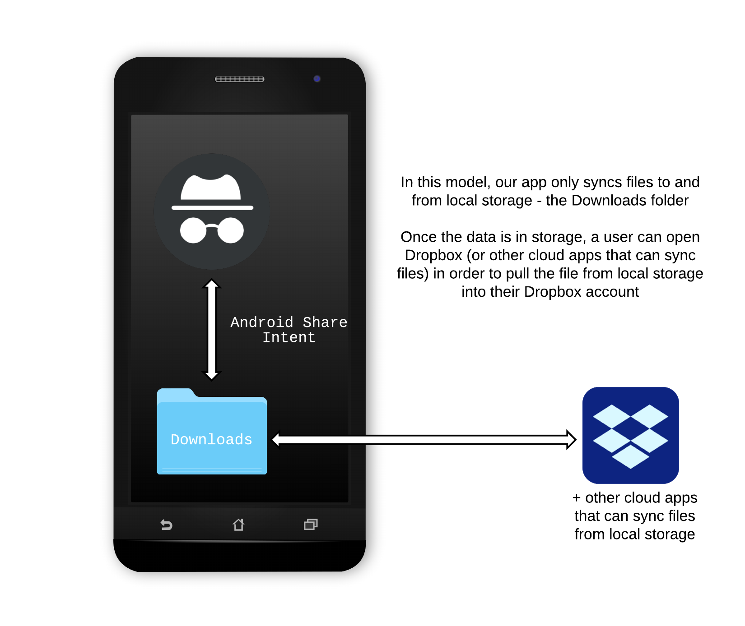
Import/Export Subsystem, continued
Final Design and Model

Slide 68
Import/Export Subsystem, continued
Coding
OOP approach using the Android API
Android Share Intent allows us to export note files to local file system
Testing
Test environment must have both Incognoto and a cloud app installed/configured
For this reason, the Android Emulator will not work because installing persistent apps to Virtual Device Images is too complicated
Instead, testing will be on a physical device
Test Environment:
Nexus 7 (2013)
Android 6.0.1 Marshmallow
Incognoto
Dropbox for Android
Google Drive for Android

Slide 69
Import/Export Subsystem, continued
Testing, continued
Testing Flow:
Create notes on device
Backup notes to Downloads folder (using ‘Backup’ button in app)
Export to PC to verify decryption from command line
Use Dropbox Share Intent to import file into Dropbox
Test Google Drive and/or other cloud apps (optional)
Import encrypted notes back into Incognoto
Verify note content on device, PC, and Dropbox
Run negative tests (e.g. backing up when no notes exist / with no cloud app installed)
Run extreme tests (e.g. backing up a very high number of notes)
Contributors
Collin – Front End: import and export features; Back End: file management

Slide 70
Scrum Report - Alex
Worked On
Finished Story #15: As a user, I want to backup my notes (7)
Notes are encrypted and exported to the Downloads folder on the user’s device
Have since changed this functionality. Now, the user is presented with a file explorer so they can choose a target directory for the backup
This was changed from our original design to send content directly to another app
Finished Story #42: I want to restore from an encrypted backup (7)
This Sprint
Story #2: I want to decrypt a notes backup from a terminal (7)

Slide 71
File Management Design (Michael)
Add, edit, delete, and view are all accessible with one click
Minimal restrictions
No character limits
No restriction on special characters
No button required to add tags
Framework/Software
Java, Android, xml
Libraries - none, all native

Slide 72
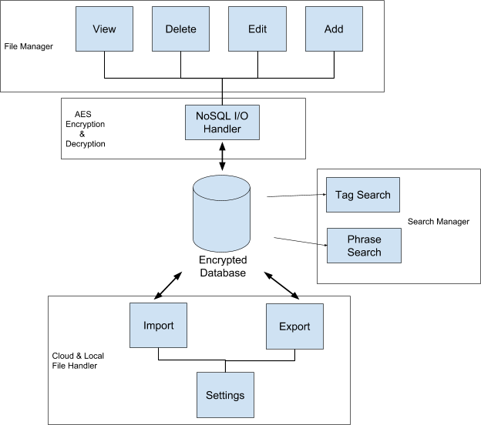
File Management
Front end - the visual representation of our notes and the functions used on them.
These functions work with the NoSQL I/O Handler to encrypt and decrypt notes
Decrypt notes so that we can view/edit
Encrypt newly added notes
Delete notes

Slide 73
File Management - Product Backlog
#34 As a user, I want to see if a note preview has more content - 1
#33 Issue where a note will get deleted without user action - 2
#27 Crash when deleting a note with multiple tags - 2
#20 As a user, I want to delete all my data at once - 2
#9 As a user, I want to be able to add a note easily - 2
#12 As a user, I want to be able to delete a note I no longer want - 1
#13 As a user, I want to be able to edit a note - 1
#17 As a user, I want to be able to scroll through all notes I have saved - 5

Slide 74
Contribution
Unit tests
As new features have been added to the app, I made sure they worked correctly
Regression tests
As the app progressed, I made sure that the new features didn’t break old features
Collaborator - Collin
Worked on the xml interface and backend

Slide 75
User Engagement and Developer Relations
Jessica
The User Engagement and Development Relations is a subsystem focused on the development of documentation to increase user engagement and understanding of the final product, a secure notes application.
Contains : User and developer focused documentation in the form of terms of service, security policy, user manual, web content, threat model, system models and test cases.
This subsystem will document the testing that was done in each technical subsystem.
Overleaf was used to create the documentation and Github will be used to host the website.

Slide 76
User Flow

Slide 77
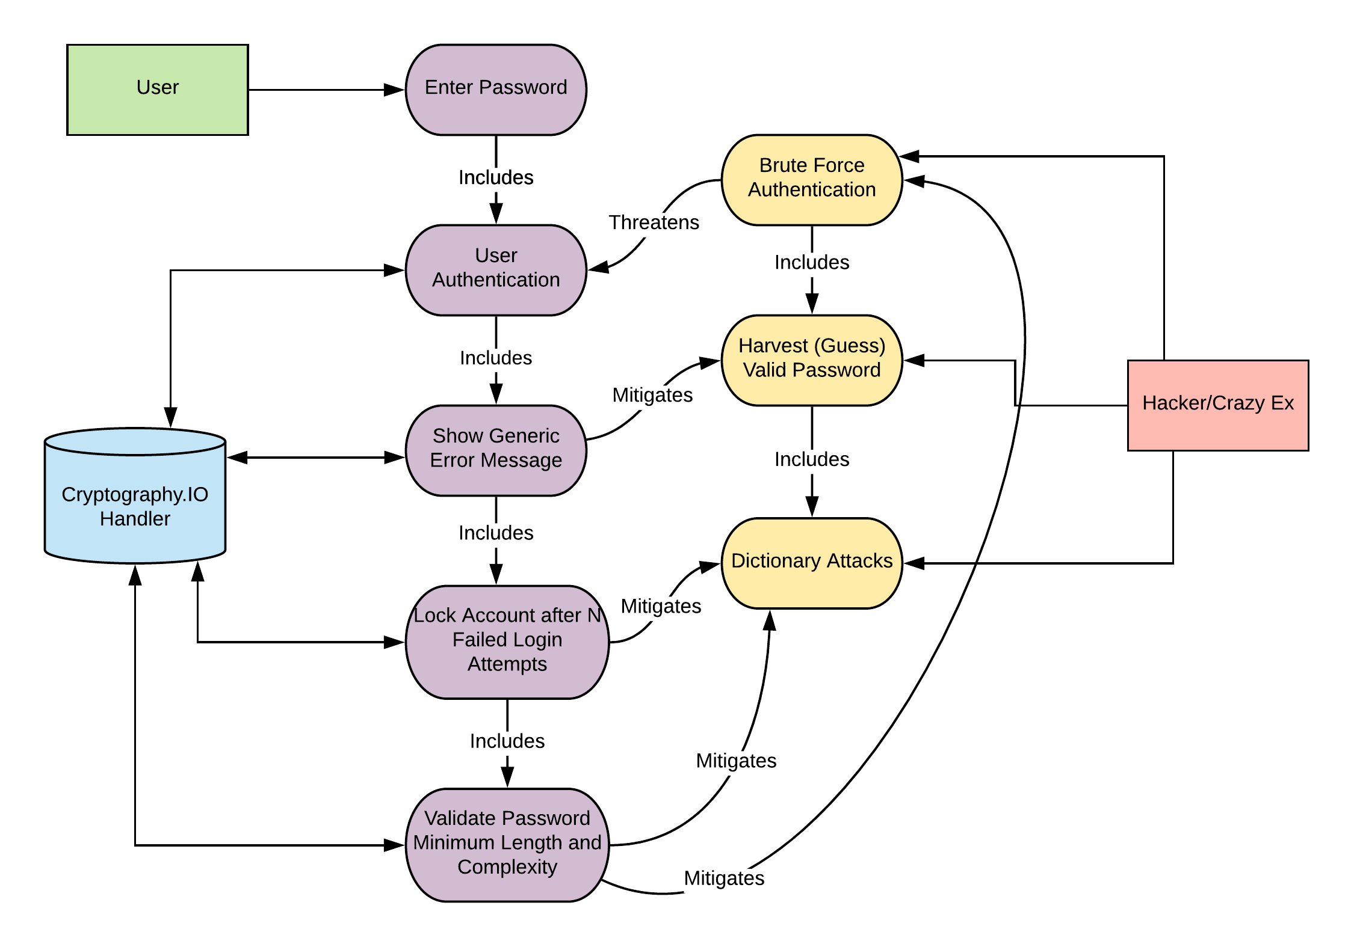
Use and Misuse Case Graph for Authentication

Slide 78
Product Backlog
#19 - As a user I want to understand what security and privacy options there are -5
#6 - As a user I want to understand the privacy and security policies before I install the app -5
#24 - As a user I want to know more about the app by reading a webpage -3
#16 - As a user I want to download the app from a trusted source -3
#43 - As a User I want to decrypt my notes using a fingerprint scanner -3
#49 - As a user I want to save my password and enter the last 4 characters as my pin to decrypt -5
#50 - As a user I want to know how the app functions from reading the manual -5
#62 - As a user I want my number of password entry attempts limited -5

Slide 79
Scrum Report - Jessica
Worked On
User Manual/Security Doc
Research into limiting password entry attempts
Began researching using a Partial Password
This Sprint
Use Cases
Implementation of limiting password entry attempts
User manual and Sec Doc
#62 - As a user I want my number of password entry attempts limited -5
#50 - As a user I want to know how the app functions from reading the manual -5

Slide 80
Incognoto
Final Presentation

Slide 81
Why Incognoto?
Corporations are constantly collecting your private, personal information.
In fact, many companies track your behavior and collect your data as part of their business model (lookin’ at you Zuck). User privacy continues to be a concern, but individuals do not have the right tools to take complete control of their data.
Incognoto, the secure notes app, is a solution to this growing problem.
Leveraging advanced cryptographic tools and strict security policies, your ideas, thoughts, and secrets are safe with Incognoto.
Notes:
Alex

Slide 82
Project Requirements
Develop a cryptographically secure mobile application
Provide multiple user authentication methods for private content
Establish a set of security and privacy guidelines for mobile apps
Document and audit code libraries for other developers to utilize in their applications
Supply adequate security to low-end Android devices in developing markets
Notes:
Michael

Slide 83
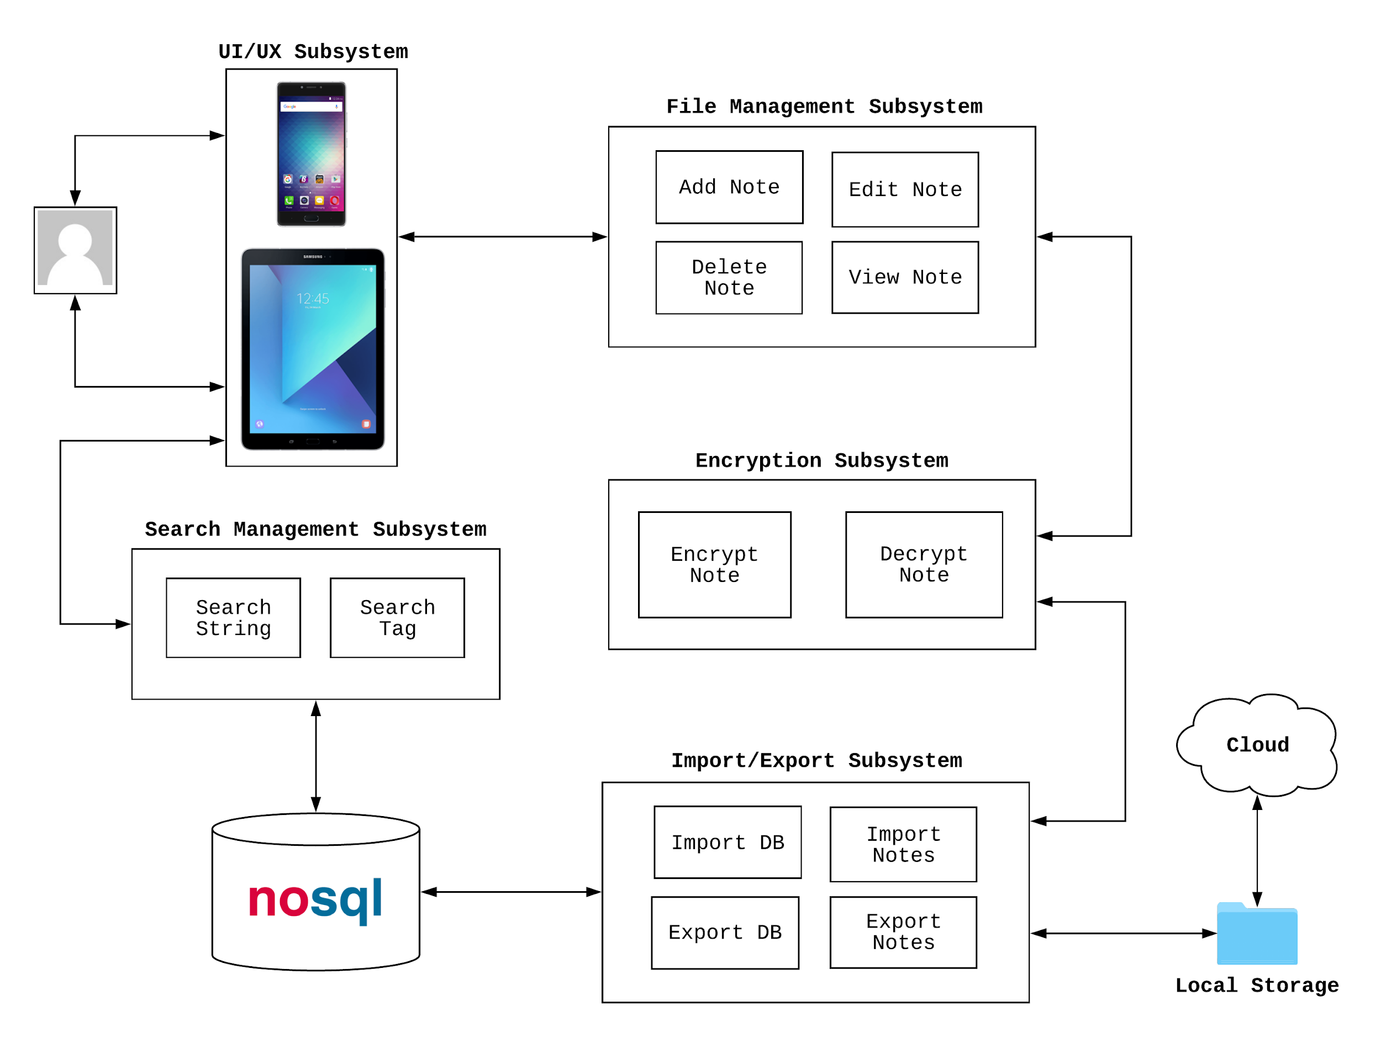
Subsystems
Notes:
Luke

Slide 84
Search Management Subsystem
Luke
Users may have a lot of notes, and finding the one you want might be hard. This subsystem allows users to quickly get the notes that they want to look at.
Important Design Decisions
Since this app uses NoSQL to store encrypted data, string parsing was the best way to look through notes at runtime.
An instance of the class that conducts searches is created for each individual search; garbage collection picks up old ones
How it's Used
Users can type what they are looking for in a search bar at the top of the app. They can also include reserved characters to do compound searches with boolean operations.
Tagging allows users to mark notes with hashtags so the most common things can be found even faster
Notes:
Luke

Slide 85
Import/Export Subsystem
Alex
The import/export subsystem allows users to import and export encrypted note content from the local file system.
Initial Design and Model
Allow user to directly backup and sync their notes using a third-party cloud provider
Initially decided to support Dropbox (using the Dropbox Core API)
Final Design and Model
Allow user to export their notes to a file
Ensures maximum security with minimal app footprint
No external services are allowed to access the app
Technical Work
Earlier sprints heavily focused on researching solutions, testing API’s, and testing file encryption/decryption in Android
Sprints 3-4: Finished implementation of import/export using Android Share Intents

Slide 86
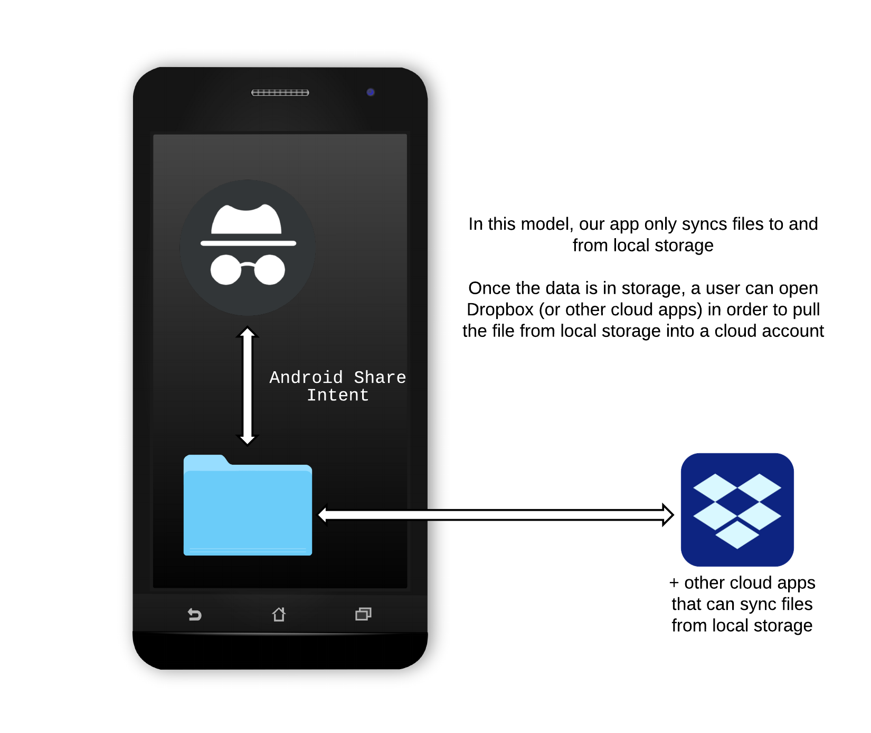
Import/Export Subsystem
Alex
Collaborators
Collaborated with Collin on research, design decisions, and implementation

Slide 87
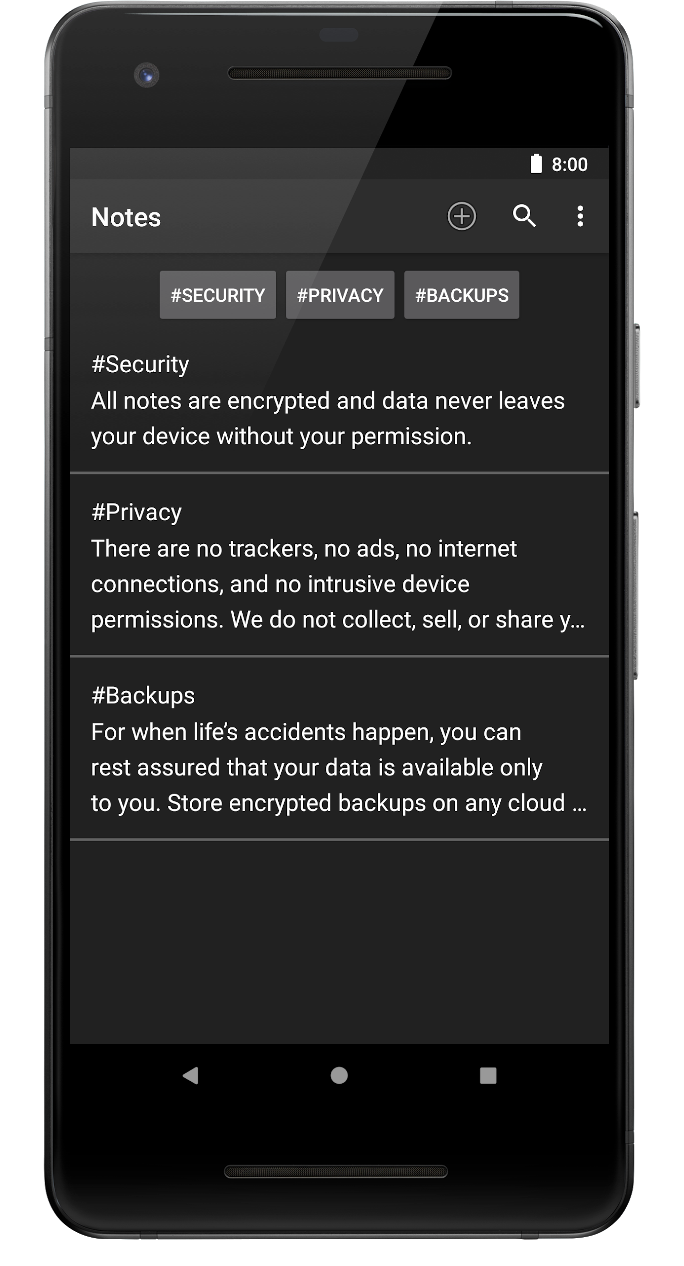
File Management Subsystem
Michael
Add, edit, delete, and view your notes
Simplistic view
Minimal restrictions
No character limits
No restriction on special characters
No button required to add tags
Few taps at most to use all features

Slide 88
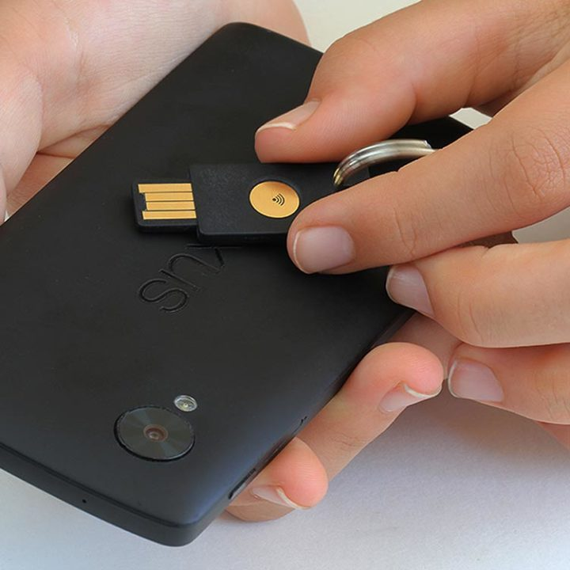
Cryptography & Authentication Subsystem
Collin
Document driven NoSQL database for encrypting and decrypting notes. Handler for data I/O that interfaces with the front end. Uses the native java.crypto and java.security classes, no external libraries. Multiple authentication methods enable ease of use and strong security.
Ensures Confidentiality, Integrity, and Accessibility of the entire system
Notes:
Collin

Slide 89
Data I/O
Notes:
Collin

Slide 90


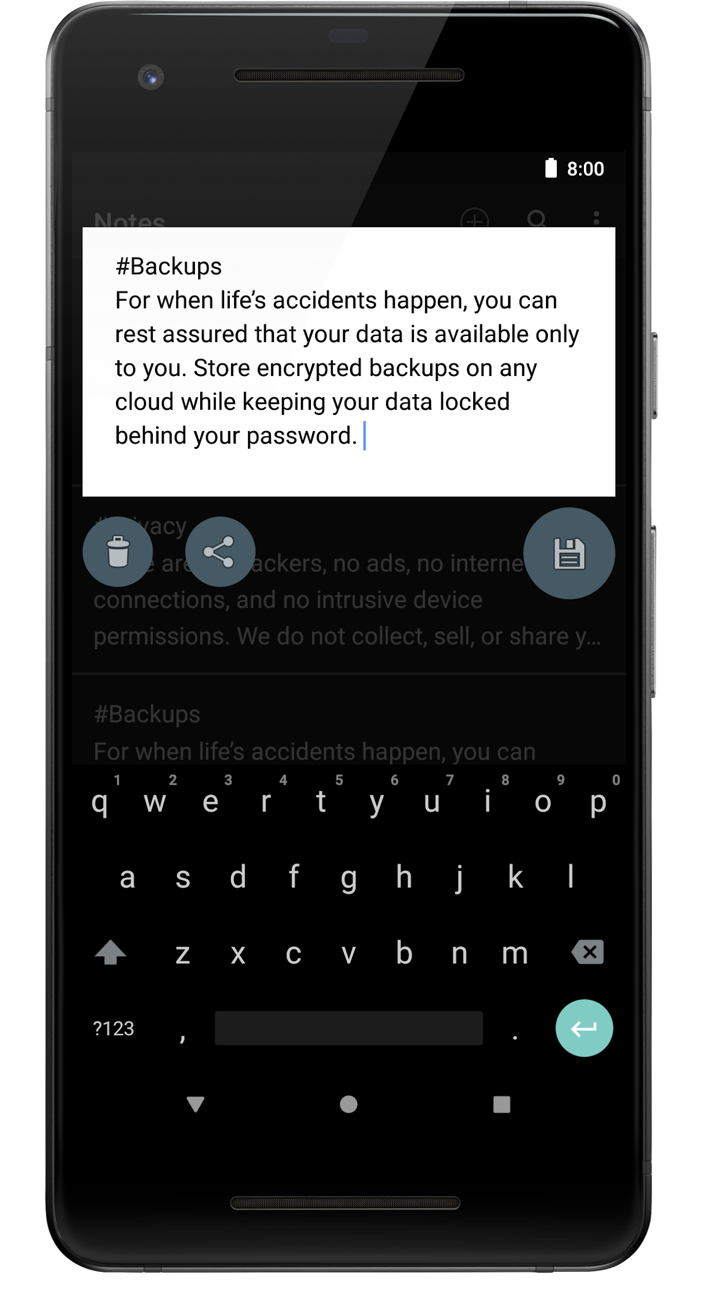
Introducing Incognoto
Take back control of your personal data.
Notes:
Collin

Slide 91
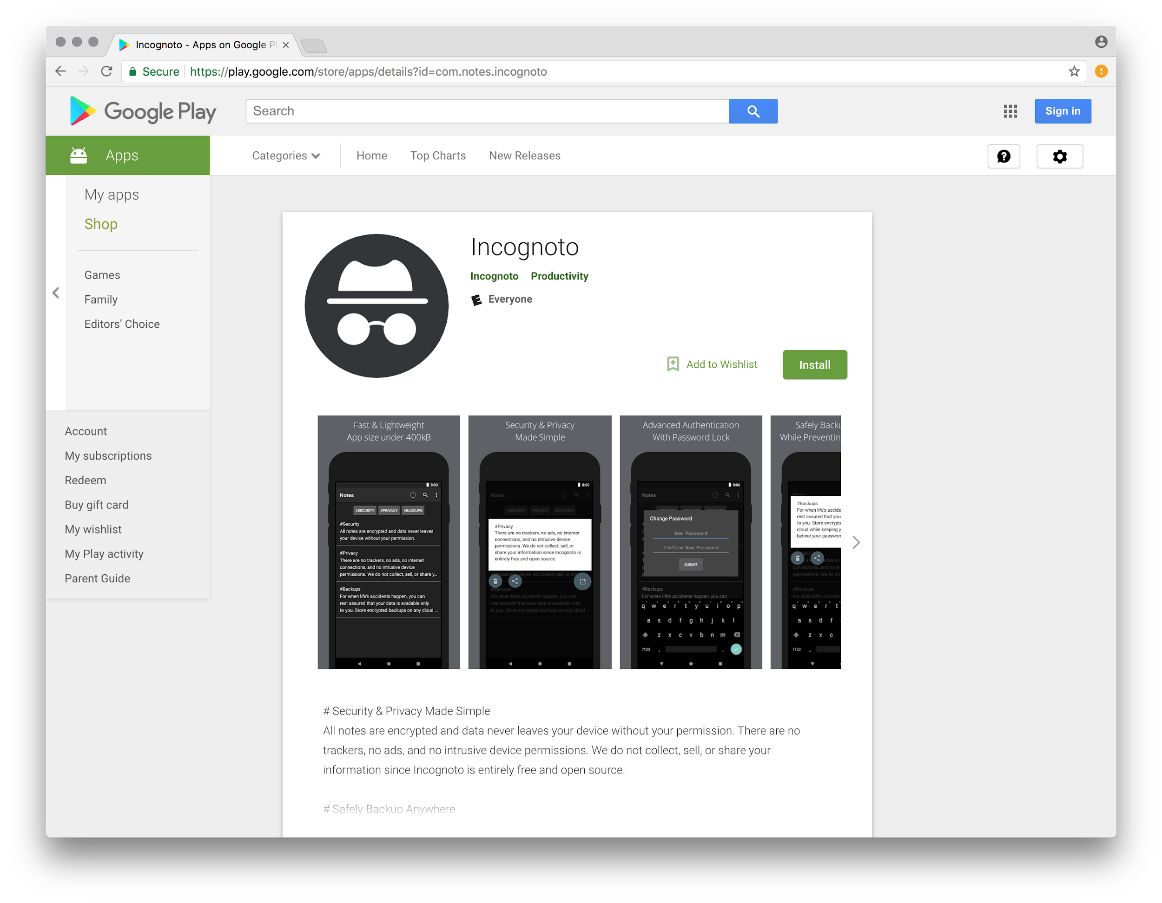

Slide 92
User Engagement / Developer Relations Subsystem
Jessica
The User Engagement and Development Relations is a subsystem focused on the development of documentation to increase user engagement and understanding of the final product, a secure notes application.
Focused on the design and creation of user and developer focused documentation in the form of terms of service, poster, security policy, user manual, web content, threat model, system models and test cases.
This subsystem will document the security and user policies as they evolve and as new products are created.
Overleaf was used to create the documentation and Github will be used to host the website.

Slide 93
Future Efforts
High Extensibility
Modular functionality that is both secure and applicable to numerous data types and systems. Design and implementation of applications to highly secure user data such as file systems, contacts, calendar, passwords, and more.
Platform for User Privacy Education
A downloadable PDF of the Security Policy combined with a PDF of the User Manual hosted on the Github page and linked to from the Google Play Store.
Foundation for Advanced Authentication
The content access control will be expanded to incorporate biometric and two factor authentication.
Notes:
Denney

